Slide 1
Machine Learning
Chapter 10, Linear Discrimination

Slide 2
Discriminant-based classification
Search for the class boundaries mathematically.
Requires a “discrimination function.”

Slide 3
Special Case
One line can separate this class from all other classes?
(Family cars? No!)
If so, a linear discrimination function will work.

Slide 4
Discriminant functions
Like a “scoring function” that gets bigger as you go towards this class.
Notation: g(x) where x is {price, hp}
Use probability density if you can! If not…
How about a simple liner function instead?

Slide 5
Discriminant functions
Example
sports cars: score g₁(x) = price + 40*hp
Electric cars: score g₂(x) = 1.1*price - 40*hp + 18000
How do you find that function?
Very hard! (See 10.5-8)
Intuition: electric cars are unusually high priced and low horsepower.

Slide 6
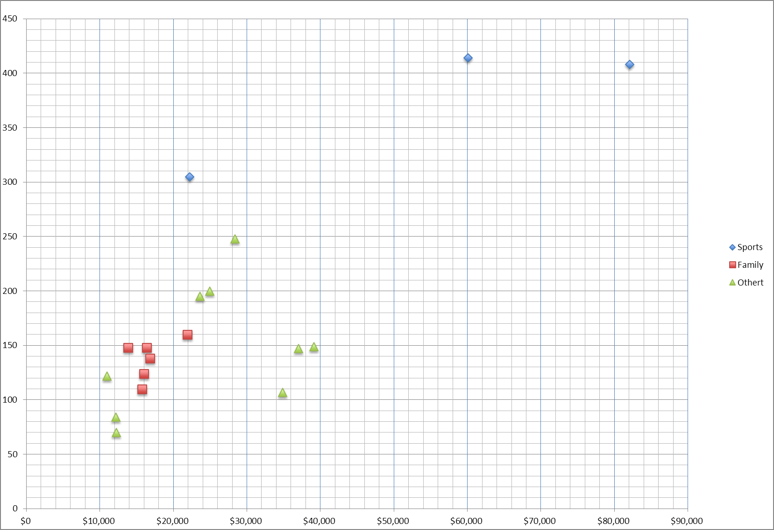
The decision
Assign to class with biggest score g(x).
Decision boundary where g₁(x) = g₂(x).
Solve to find the equation of the boundary:
g1 > g2
hp = 0.00125 price + 225
g1 = g2
g1 < g2

Slide 7
Simplified approach (2 classes)
Define one g(x) = g₁(x) – g₂(x)
Assign to class
C₁ if g(x) > 0
C₂ if g(x) ≤ 0

Slide 8
10.2 If linear doesn’t work?
Skip this section…

Slide 9
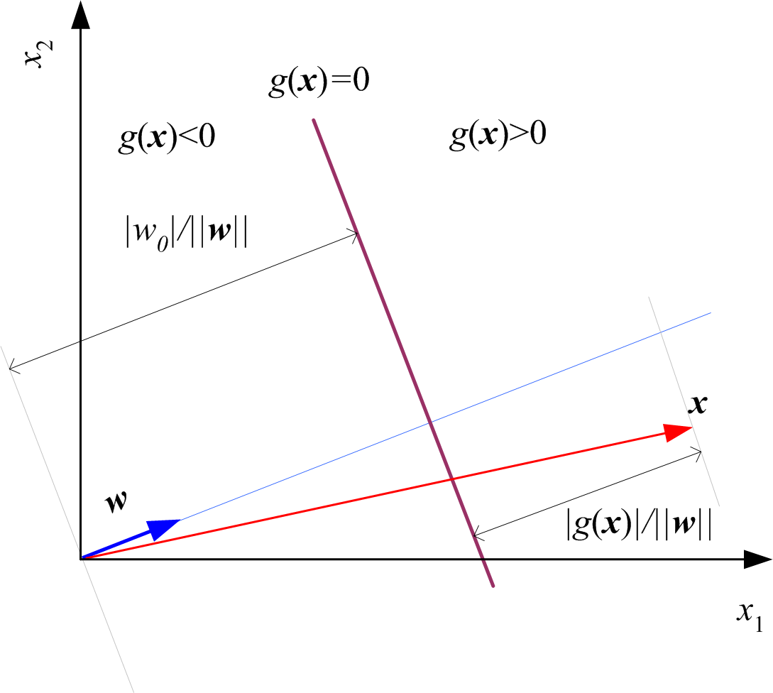
10.3 Graphical interpretation
Write g(x) in matrix form: g(x) = w^{T}x + w₀
w represents a vector perpendicular to the boundary
w₀ is the distance from the origin

Slide 10
10.4 Pairwise separation
Remember:
If a line can’t separate this class from all others, the method doesn’t work!
If not, pairwise separation:
Separate them in pairs, classify by checking all pairings one at a time.

Slide 11
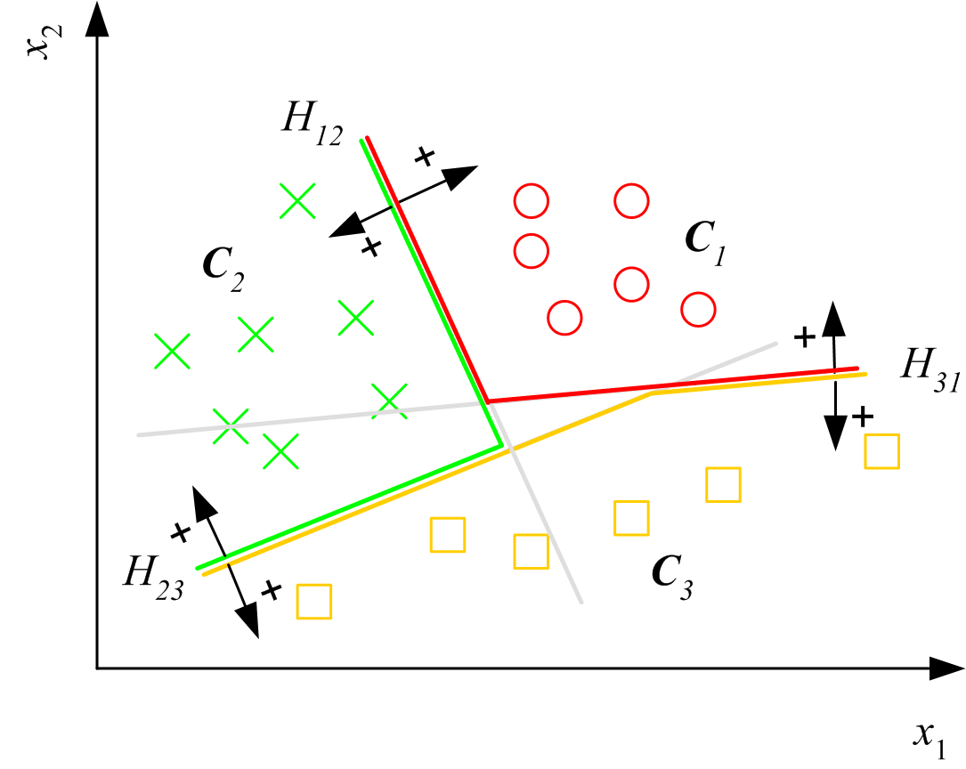
Pairwise separation (C₁ cannot be separated by one line)

Slide 12
How to find g(x)?
10.5 From probabilities (if you can)
10.6 Iterative optimization (trial and error)
Including:
10.7 Ratio of probabilities
10.8 Regression

Slide 13
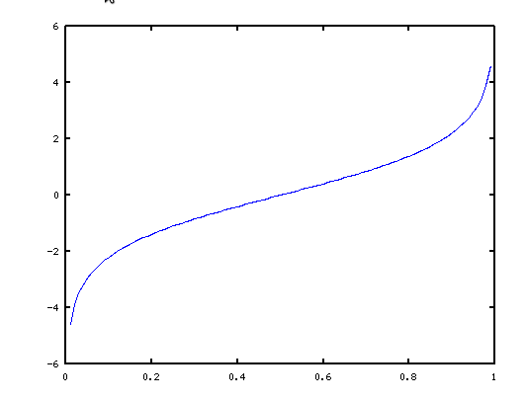

10.5 g(x) from probabilities
Two classes P(C₁|x)=y, P(C₂|x) = 1-y
Choose C₁ if y > 0.5
Transform to get a decision at >0 ?
Best: “logit” transformation $log\left(\frac{y}{1−y}\right)$
Maps 0→1 to -∞ → ∞

Slide 14
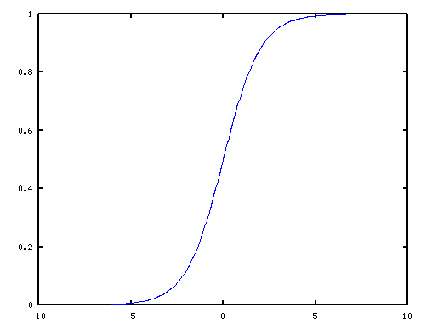

g = $log\left(\frac{y}{1−y}\right)$
Solve for y?
$y=\frac{1}{1−e^{−g}}$
The famous “Sigmoid” function:

Slide 15
10.6 Gradient descent
If you can write an equation for E(w) (not easy!)
Guess an initial value for each w_{i}
Calculate the gradient, determines ∆w_{i}
Standard calculus, will find at least a local minimum

Slide 16
10.7 Logistic Discrimination
One way to get an error function.
Very advanced!

Slide 17
10.8 Discrimination by regression
Another way to get an error function.
Good for highly overlapping classes.

